Slide 1
Regularization: Bias Variance Tradeoff
.

Slide 2
Acknowledgements
Chapter 7, Deep Learning book
Ali Ghodsi’s Video Lectures on Regularizationª
Dropout: A Simple Way to Prevent Neural Networks from Overfitting^{b} CS6910: Deep Learning Course by Prof. Mitesh M. Khapra, IIT Madras, India

Slide 4
https://prasenjit123.github.io/DL_animations/polynomial-curve-fitting
https://prasenjit123.github.io/DL_animations/polynomial-terms-vs-superposition

Slide 5
Bias and Variance

Slide 6
https://prasenjit123.github.io/DL_animations/bias_variance/
Simple models: Different samples → similar models → far from the true curve → high bias / underfitting
Complex models: Different samples → very different models → high variance

Slide 7
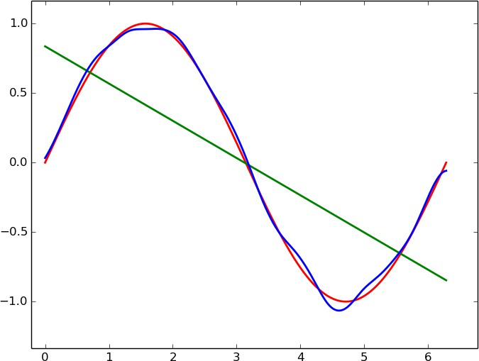

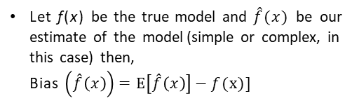
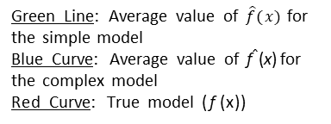
Let f(x) be the true model and $\hat{f}(x)$ be our estimate of the model (simple or complex, in this case) then,
Bias $\left(\hat{f}\left(x\right)\right)=E\left[\hat{f}\left(x\right)\right]−f(x)]$
E[$\hat{f}(x)]$ is the expected value of the model
The simple model the average value (green line) is very far from the true value f(x)
Green Line: Average value of $\hat{f}(x)$for the simple model
Blue Curve: Average value of f^{ˆ}(x) for the complex model
Red Curve: True model (f (x))
Mathematically, this means that the simple model has a high bias
In contrast, the complex model has a low bias

Slide 8
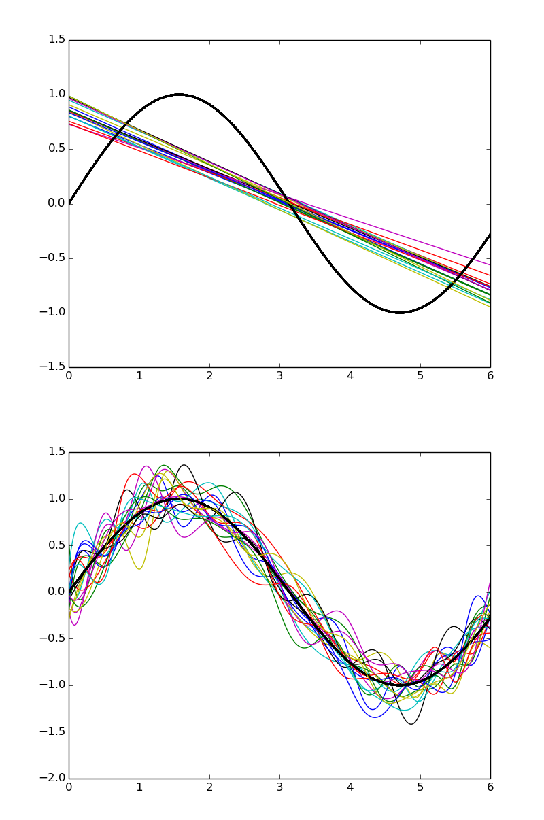
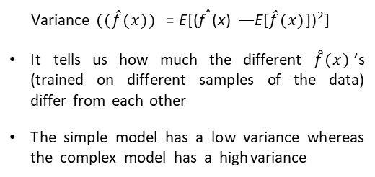
Variance $((\hat{f}(x))$= E[(f^{ˆ}(x) — E[$\hat{f}(x)$])²]
It tells us how much the different $\hat{f}(x)$’s (trained on different samples of the data) differ from each other
The simple model has a low variance whereas the complex model has a high variance

Slide 9
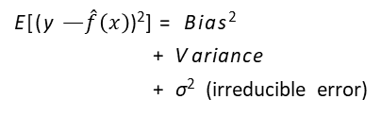
Simple model: high bias, low variance
Complex model: low bias, high variance
There is always a trade-off between the bias and variance
                Both bias and variance contribute to the mean square error
E[(y — $\hat{f}\left(x\right)$)²] = Bias²
+ V ariance
+ σ² (irreducible error)

Slide 10
Train error vs Test error

Slide 11


Consider a new point (x, y) which was not seen during training
If we use the model $\hat{f}(x)$to predict the value of y then the mean square error is given by
E[(y — $\hat{f}\left(x\right))$²]

Slide 12
Bias vs Variance curve

Slide 13

The parameters of $\hat{f}(x)$ (all w$i$ ’s) are trained
using a training set {(x_{i}, y_{i})}^{n}
error
High bias
High variance
i=1
However, at test time we are interested in evaluating the model on a validation (unseen) set which was not used for training
ideal model complexity
This gives rise to the following two entities of interest:
train_{err} (say, mean square error) test_{err} (say, mean square error)
model complexity

Slide 14
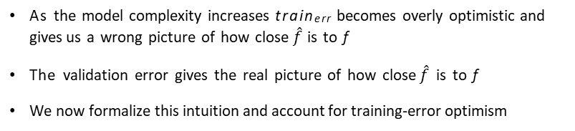

Intuitions developed so far
Let there be n training points and m test (validation) points
$$\frac{1}{n}$$
n
ˆ
2
train =
Σ
(y - f (x ))
err
i i
i=1
$$\frac{1}{m}$$
test =
n+m
ˆ
Σ
2
err
(y - f (x ))
i=n+1
i i
As the model complexity increases train_{err} becomes overly optimistic and gives us a wrong picture of how close $\hat{f}$ is to f
The validation error gives the real picture of how close $\hat{f}$ is to f
We now formalize this intuition and account for training-error optimism

Slide 15
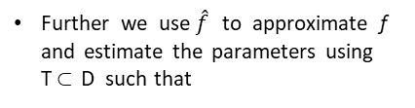
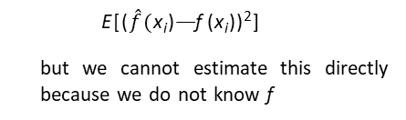


Further we use $\hat{f}$ to approximate f and estimate the parameters using T⊂ D such that
Let D={x_{i}, y_{i}}^{m+n}, then for any
i=1
point (x, y) we have,
$\hat{y}$_{i} = $\hat{f}($x_{i})
y_{i} = f (x_{i}) + ε_{i}
y_{i} is related to x_{i} by some true function f but there is also some noise ε in the relation
We are interested in knowing
E[($\hat{f}($x_{i})— f (x_{i}))²]
but we cannot estimate this directly because we do not know f
For simplicity, we assume
ε ∼ N (0, σ²)
how to estimate this empirically using the observation y_{i} & prediction $\hat{y}$_{i}?
and of course we do not know f

Slide 16

E[($\hat{y}$_{i} - y_{i})²] = E[($\hat{f}($x_{i}) - f (x_{i}) - ε_{i})²] (y_{i} = f (x_{i}) + ε_{i})
= E[($\hat{f}($x_{i}) - f (x_{i}))² - 2ε_{i}($\hat{f}($x_{i}) - f (x_{i})) + ε_{i}²]
= E[($\hat{f}($x_{i}) - f (x_{i}))²] - 2E[ε_{i}($\hat{f}($x_{i}) - f (x_{i}))] + E[ε_{i}²]
E[$\hat{f}($x_{i}) - f (x_{i}))²] = E[($\hat{y}$_{i} - y_{i})²] - E[ε_{i}²] + 2E[ε_{i}($\hat{f}($x_{i}) - f (x_{i}))]

Slide 17


Suppose we have observed the goals scored(z) in k matches as z₁ = 2, z₂ = 1, z₃ = 0, ... z_{k} = 2
Now we can empirically estimate E[z] i.e. the expected number of goals scored as
$$\frac{1}{k}$$
k
z
E[z] =
Σ
i
i=1
We have a certain number of observations y_{i} & predictions $\hat{y}$_{i} using which we can estimate
$$\frac{1}{m}$$
m
2
2
E[($\hat{y}$_{i}— y ) ] =
Σ
($\hat{y}$_{i}— y_{i})
i
i=1

Slide 18

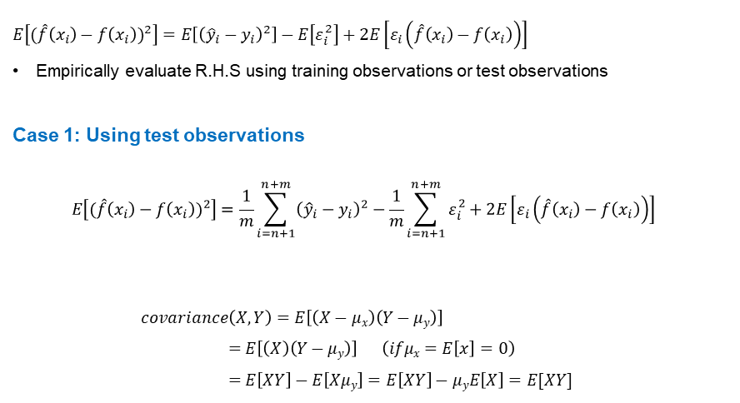



$$E\left[{(\hat{f}\left(x_{i}\right)−f\left(x_{i}\right))}^{2}\right]=E\left[{\left({\hat{y}}_{i}−y_{i}\right)}^{2}\right]−E\left[ε_{i}^{2}\right]+2E\left[ε_{i}\left(\hat{f}\left(x_{i}\right)−f\left(x_{i}\right)\right)\right]$$
Empirically evaluate R.H.S using training observations or test observations
Case 1: Using test observations
$$E\left[{(\hat{f}\left(x_{i}\right)−f\left(x_{i}\right))}^{2}\right]=\frac{1}{m}\sum_{i=n+1}^{n+m}{{\left({\hat{y}}_{i}−y_{i}\right)}^{2}}−\frac{1}{m}\sum_{i=n+1}^{n+m}{ε_{i}^{2}}+2E\left[ε_{i}\left(\hat{f}\left(x_{i}\right)−f\left(x_{i}\right)\right)\right]$$
$covariance\left(X,Y\right)=E\left[\left(X−μx\right)\left(Y−μy\right)\right]$
$$=E\left[\left(X\right)\left(Y−μy\right)\right] \left(ifμx=E\left[x\right]=0\right)$$
$$=E\left[XY\right]−E\left[Xμy\right]=E\left[XY\right]−μyE\left[X\right]=E[XY]$$
$$true error$$
$$empirical estimation$$
$$of error$$
$$small constant$$
$$covariance(ε_{i}, \hat{f}\left(x_{i}\right)−f\left(x_{i}\right))$$

Slide 19

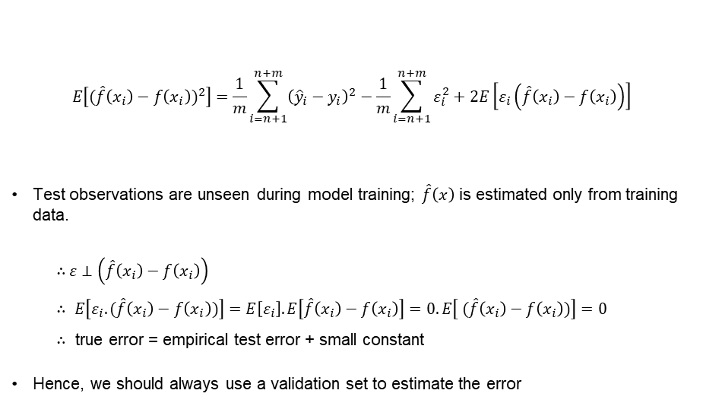



$$E\left[{(\hat{f}\left(x_{i}\right)−f\left(x_{i}\right))}^{2}\right]=\frac{1}{m}\sum_{i=n+1}^{n+m}{{\left({\hat{y}}_{i}−y_{i}\right)}^{2}}−\frac{1}{m}\sum_{i=n+1}^{n+m}{ε_{i}^{2}}+2E\left[ε_{i}\left(\hat{f}\left(x_{i}\right)−f\left(x_{i}\right)\right)\right]$$
Test observations are unseen during model training; $\hat{f}\left(x\right)$ is estimated only from training data.
∴ $ε⊥$ $\left(\hat{f}\left(x_{i}\right)−f\left(x_{i}\right)\right)$
$$∴ E\left[ε_{i}.(\hat{f}\left(x_{i}\right)−f\left(x_{i}\right))\right]=E\left[ε_{i}\right].E\left[\hat{f}\left(x_{i}\right)−f\left(x_{i}\right)\right]=0.E\left[ (\hat{f}\left(x_{i}\right)−f\left(x_{i}\right))\right]=0$$
$∴$ true error = empirical test error + small constant
Hence, we should always use a validation set to estimate the error
$$true error$$
$$Empirical estimation error$$
$$small constant$$
$$covariance(ε_{i} ,\hat{f}\left(x_{i}\right)−f\left(x_{i}\right))$$

Slide 20
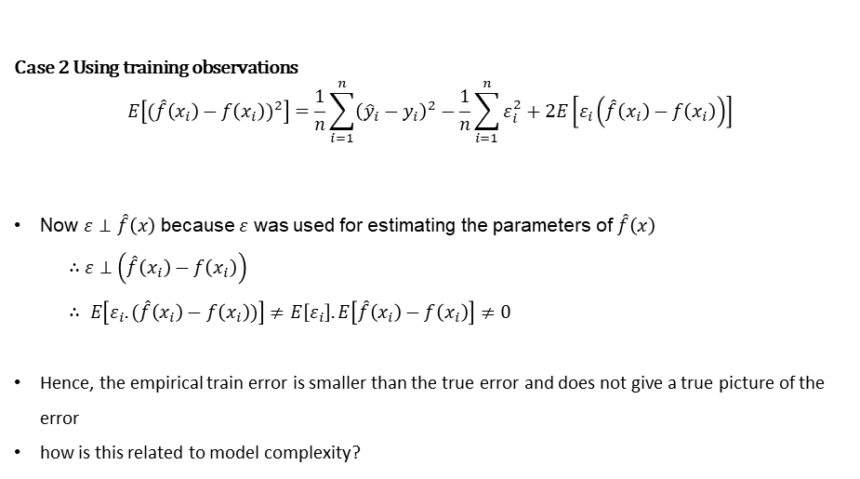



Case 2 Using training observations
$$E\left[{(\hat{f}\left(x_{i}\right)−f\left(x_{i}\right))}^{2}\right]=\frac{1}{n}\sum_{i=1}^{n}{{\left({\hat{y}}_{i}−y_{i}\right)}^{2}}−\frac{1}{n}\sum_{i=1}^{n}{ε_{i}^{2}}+2E\left[ε_{i}\left(\hat{f}\left(x_{i}\right)−f\left(x_{i}\right)\right)\right]$$
Now $ε$ $⊥$ $\hat{f}\left(x\right)$ because $ε$ was used for estimating the parameters of $\hat{f}\left(x\right)$
∴ $ε⊥$ $\left(\hat{f}\left(x_{i}\right)−f\left(x_{i}\right)\right)$
$$∴ E\left[ε_{i}.(\hat{f}\left(x_{i}\right)−f\left(x_{i}\right))\right]≠E\left[ε_{i}\right].E\left[\hat{f}\left(x_{i}\right)−f\left(x_{i}\right)\right]≠0$$
Hence, the empirical train error is smaller than the true error and does not give a true picture of the error
how is this related to model complexity?
$$true error$$
$$covariance(ε_{i} ,\hat{f}\left(x_{i}\right)−f\left(x_{i}\right))$$
$$Empirical estimation error$$
$$small constant$$

Slide 21
True error and Model complexity

Slide 22

Using Stein’s Lemma (and some trickery) we can show that
1
n
2
n
ˆ
n
ˆ
σ ∂f (x )
Σ
ε (f (x ) — f (x )) =
Σ
i
i i i
n ∂y_{i}
i=1 i=1
When will $\frac{∂\hat{f}(x_{i})}{∂y_{i}}$ be high? When a small change in the observation causes a large change in the estimation$(\hat{f})$
A complex model will be more sensitive to changes in observations whereas a simple model will be less sensitive to changes in observations
true error = empirical train error + small constant + Ω(model complexity)

Slide 23
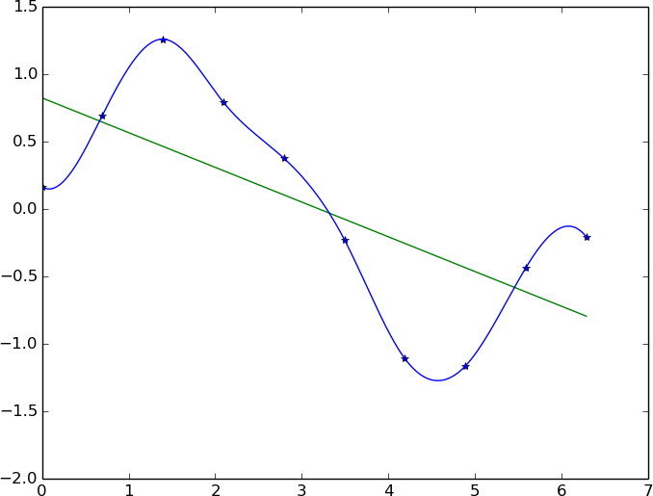
Let us verify that indeed a complex model is more sensitive to minor changes in the data
We have fitted a simple and complex model for some given data

Slide 24
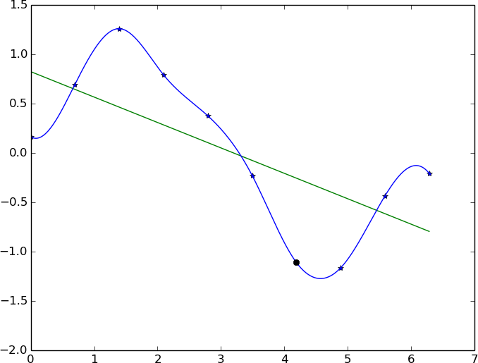
Let us verify that indeed a complex model is more sensitive to minor changes in the data
We have fitted a simple and complex model for some given data
We now change one of these data points

Slide 25
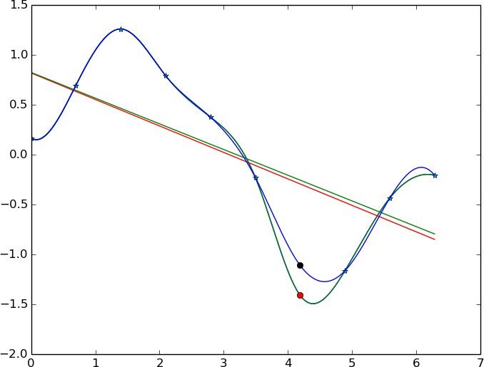
Let us verify that indeed a complex model is more sensitive to minor changes in the data
We have fitted a simple and complex model for some given data
We now change one of these data points
The simple model does not change much as compared to the complex model

Slide 26

Hence while training, instead of minimizing the training error L_{train}(θ) we should minimize
min L_{train}(θ) + Ω(θ) = L (θ)
w.r.t θ
Where Ω(θ) would be high for complex models and small for simple models
Ω(θ) acts as an approximate for
σ
2
Σ
n ∂$\hat{f}$(x_{i})
i=1 ∂y_{i}
n
This is the basis for all regularization methods
We can show that l₁ regularization, l₂ regularization, early stopping and injecting noise in input are all instances of this form of regularization.

Slide 27

High variance
error
High bias
σ
2
n ∂$\hat{f}$(xi)
i=1 ∂yi
Ideal trade-off
Σ
n
model complexity
Ω(θ) should ensure that model has reasonable complexity

Slide 28
Why do we care about this bias variance tradeoff and model complexity?
Deep Neural networks are highly complex models.
Many parameters, many nonlinearities.
It is easy for them to overfit and drive training error to 0.
Hence we need some form of regularization.

Slide 29
Different forms of regularization
l₂ regularization
Dataset augmentation
Parameter Sharing and tying
Adding Noise to the inputs
Adding Noise to the outputs
Early stopping
Ensemble methods
Dropout

Slide 30
Thank You

